Slide 1



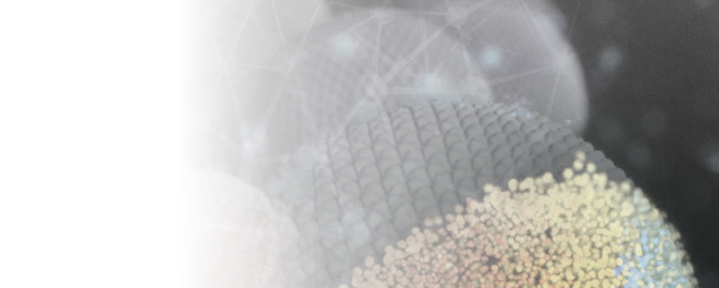
CLIJ: GPU-accelerated
image processing for everyone
Robert Haase
ImageJ Macro Course, February 2021
Notes:
Good morning everyone, my name is Stephan Grill, and I am excited to present to you our Cluster of Excellence Application ‘PHYSICS OF LIFE’ -Klick-

Slide 2
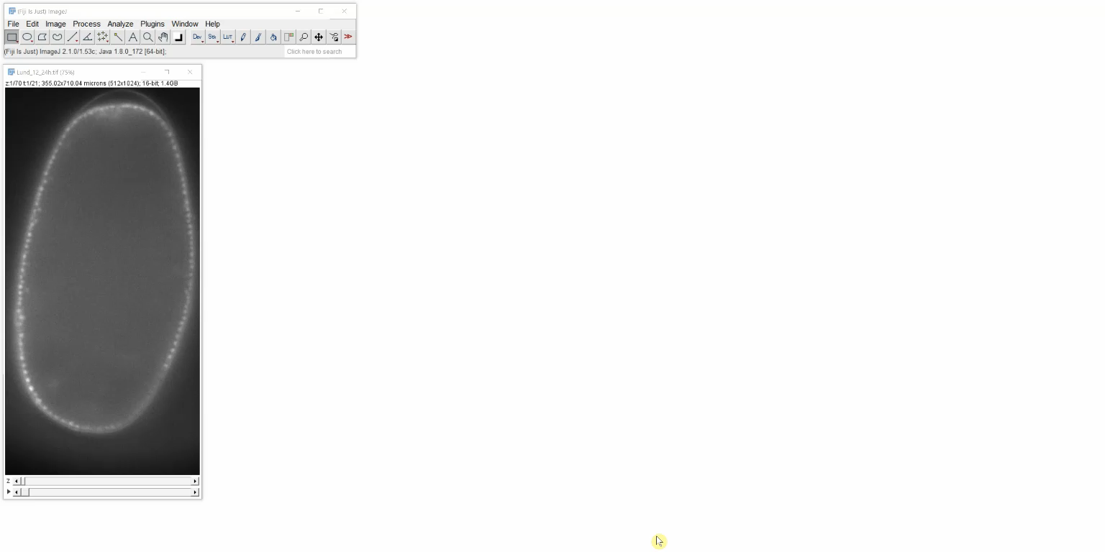
Image processing in life-sciences
State-of-the-art software for more than 20 years: ImageJ / Fiji
2x
https://imagej.nih.gov/ij/ https://fiji.sc

Slide 3
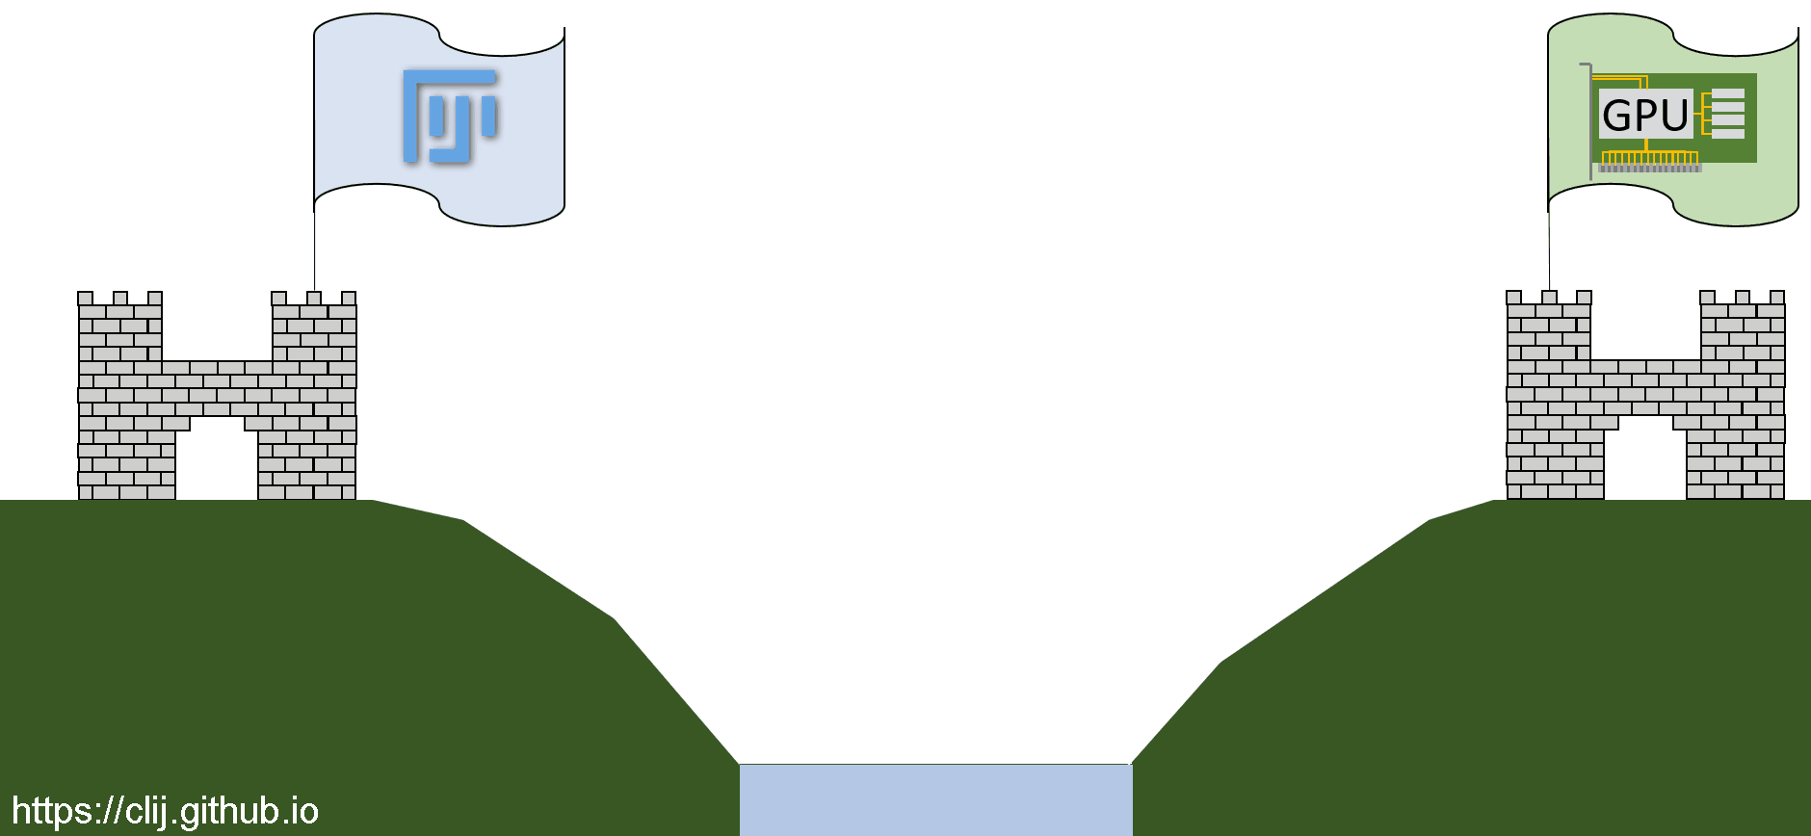
ImageJ / Fiji integration for OpenCL

Slide 4
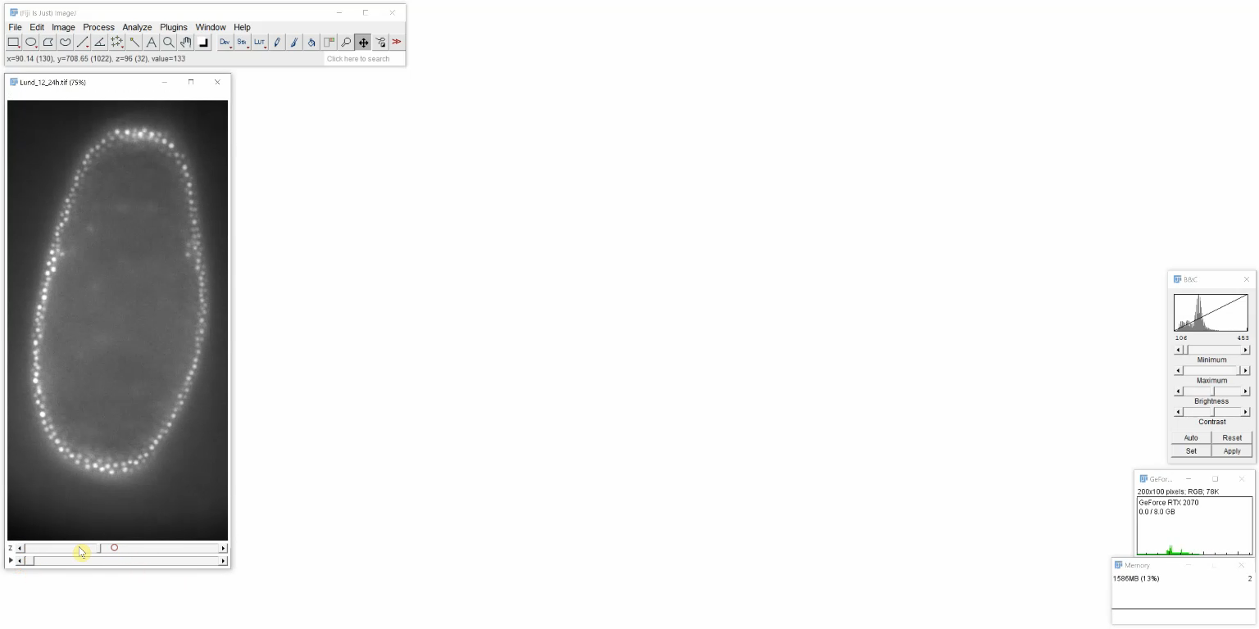
How image processing is supposed to be
(… in my honest opinion)
2x
https://clij.github.io/assistant

Slide 5
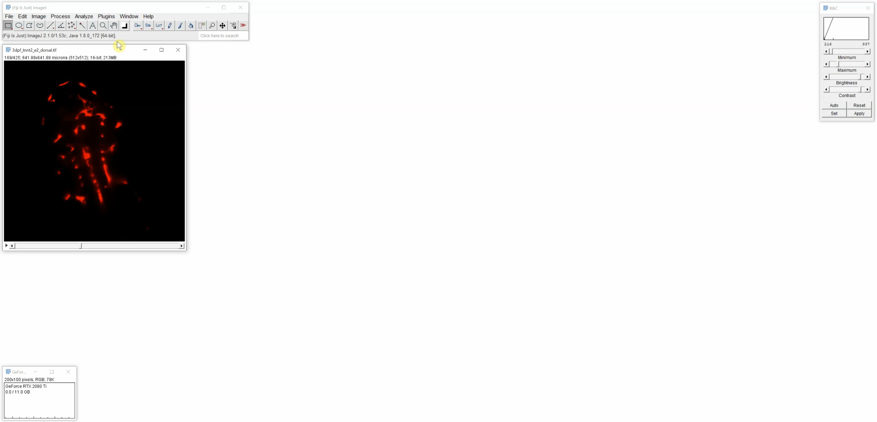
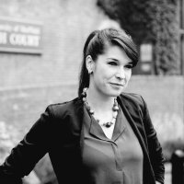
GPU acceleration + code generation
After setting up the workflow, generate code!
Special thanks to Elisabeth Kugler!
Elisabeth Kugle
@KuglerElisabeth
Image data source: Elisabeth Kugler; labs of Tim Chico and Paul Armitage, The University of Sheffield (UK)" https://zenodo.org/record/4204839#.X8DCRGj7Q2w

Slide 6
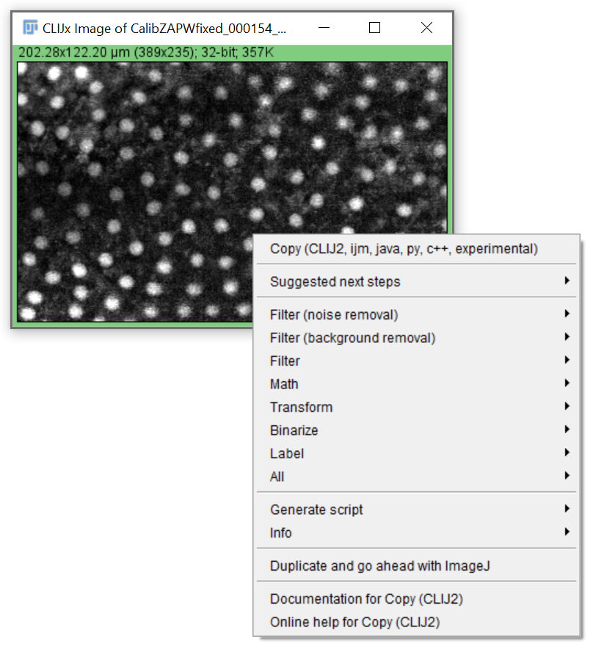
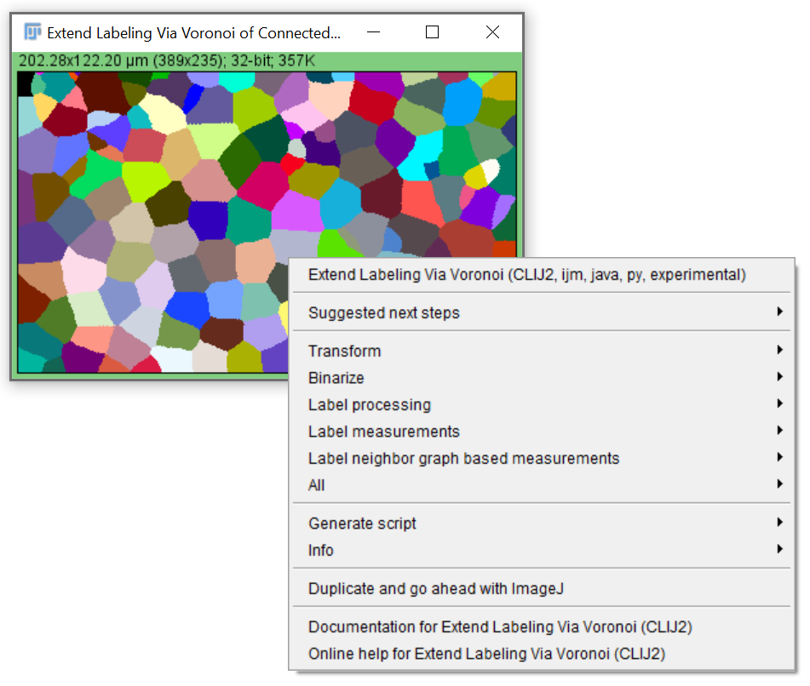
Image Data Flow Graph design
The menu order is intentional: From preprocessing to analysis
https://clij.github.io/assistant

Slide 7
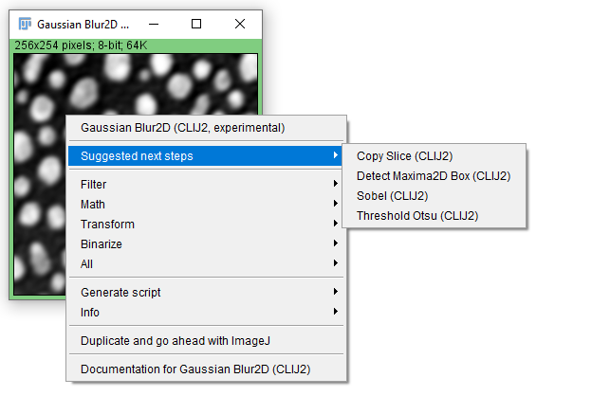
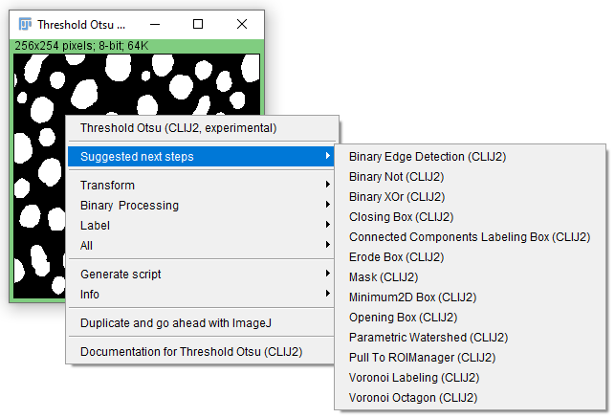
Expert system: Suggestions
Explore suggestions!
https://clij.github.io/assistant

Slide 8
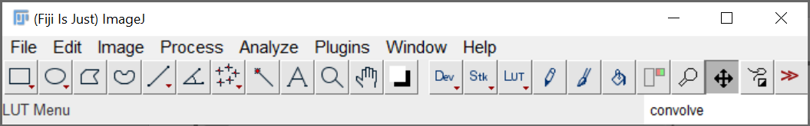
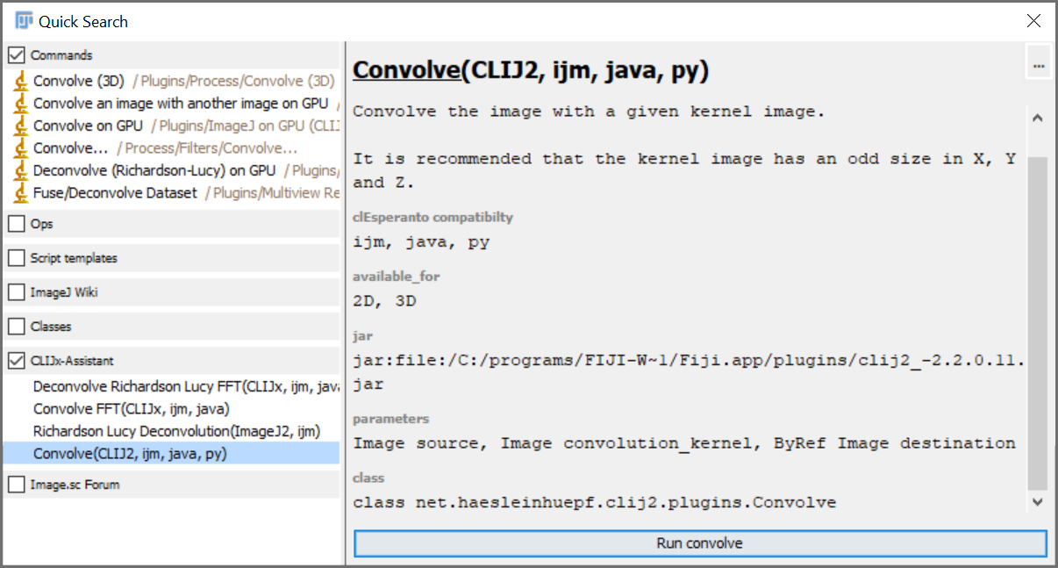
Fiji search bar
In Fijis search bar result, there is a new category: CLIJx-assistant which offers IDFG operations

Slide 9
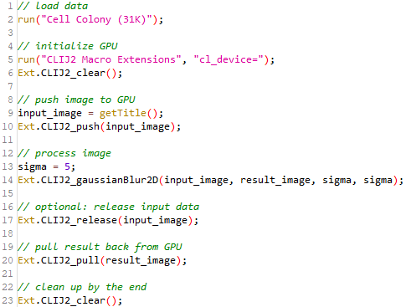
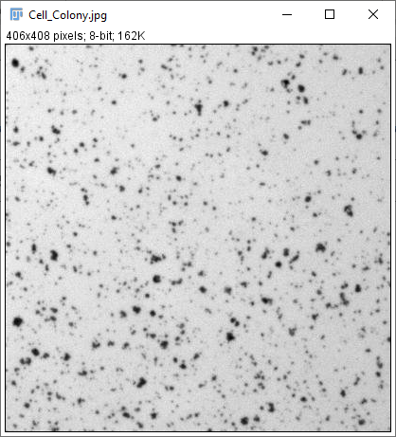
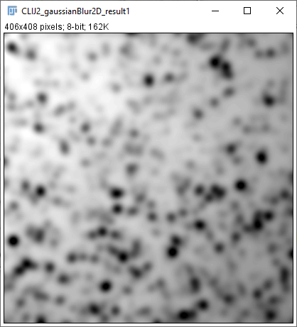

CLIJ2: What every ImageJ Macro script must have
Load data
Initialize GPU
Push
Process images
Pull
Cleanup
@haesleinhuepf

Slide 10
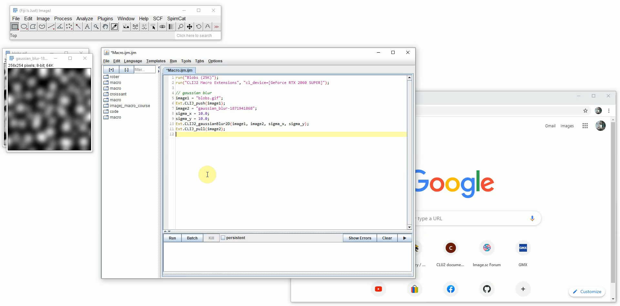
CLIJ2: Macro editing

Slide 11
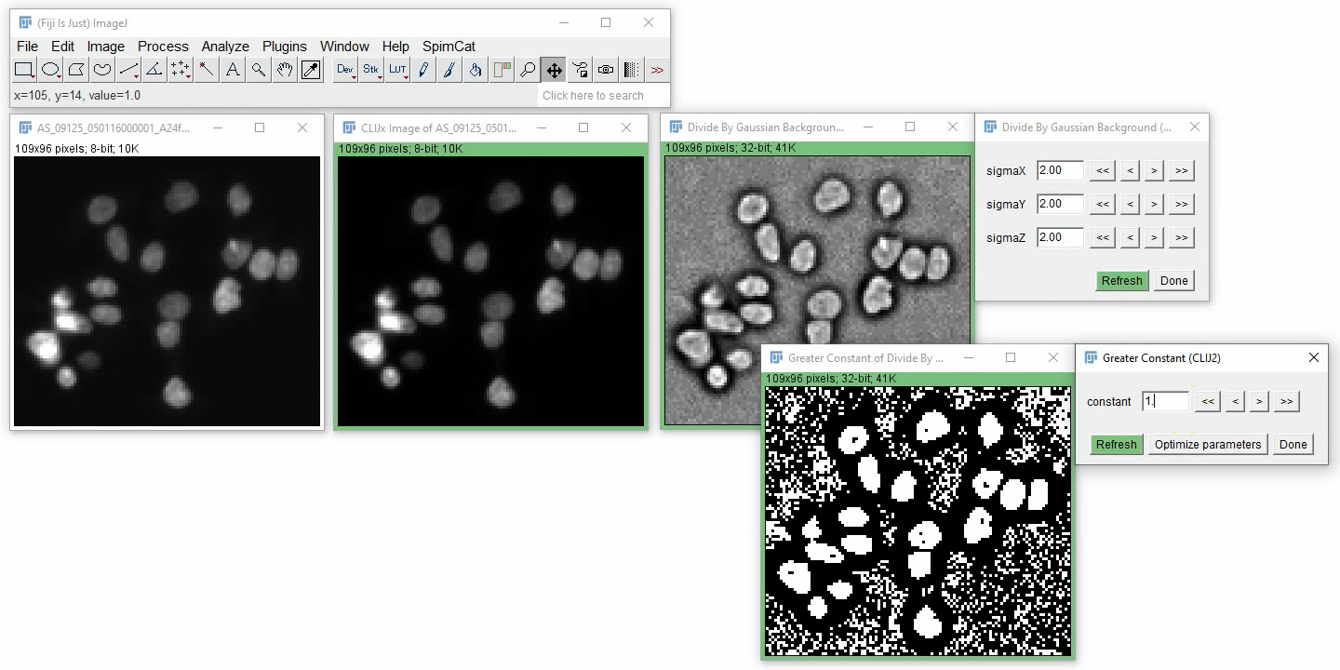
Parameter optimization
If your image data flow graph ends in a binary image, you can optimize numeric parameters automatically.

Slide 12
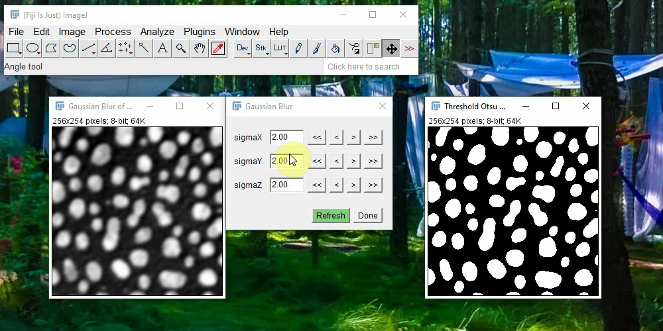
Reset parameters
If you or the optimizer screwed up parameter settings, you can get them back from the history!

Slide 13
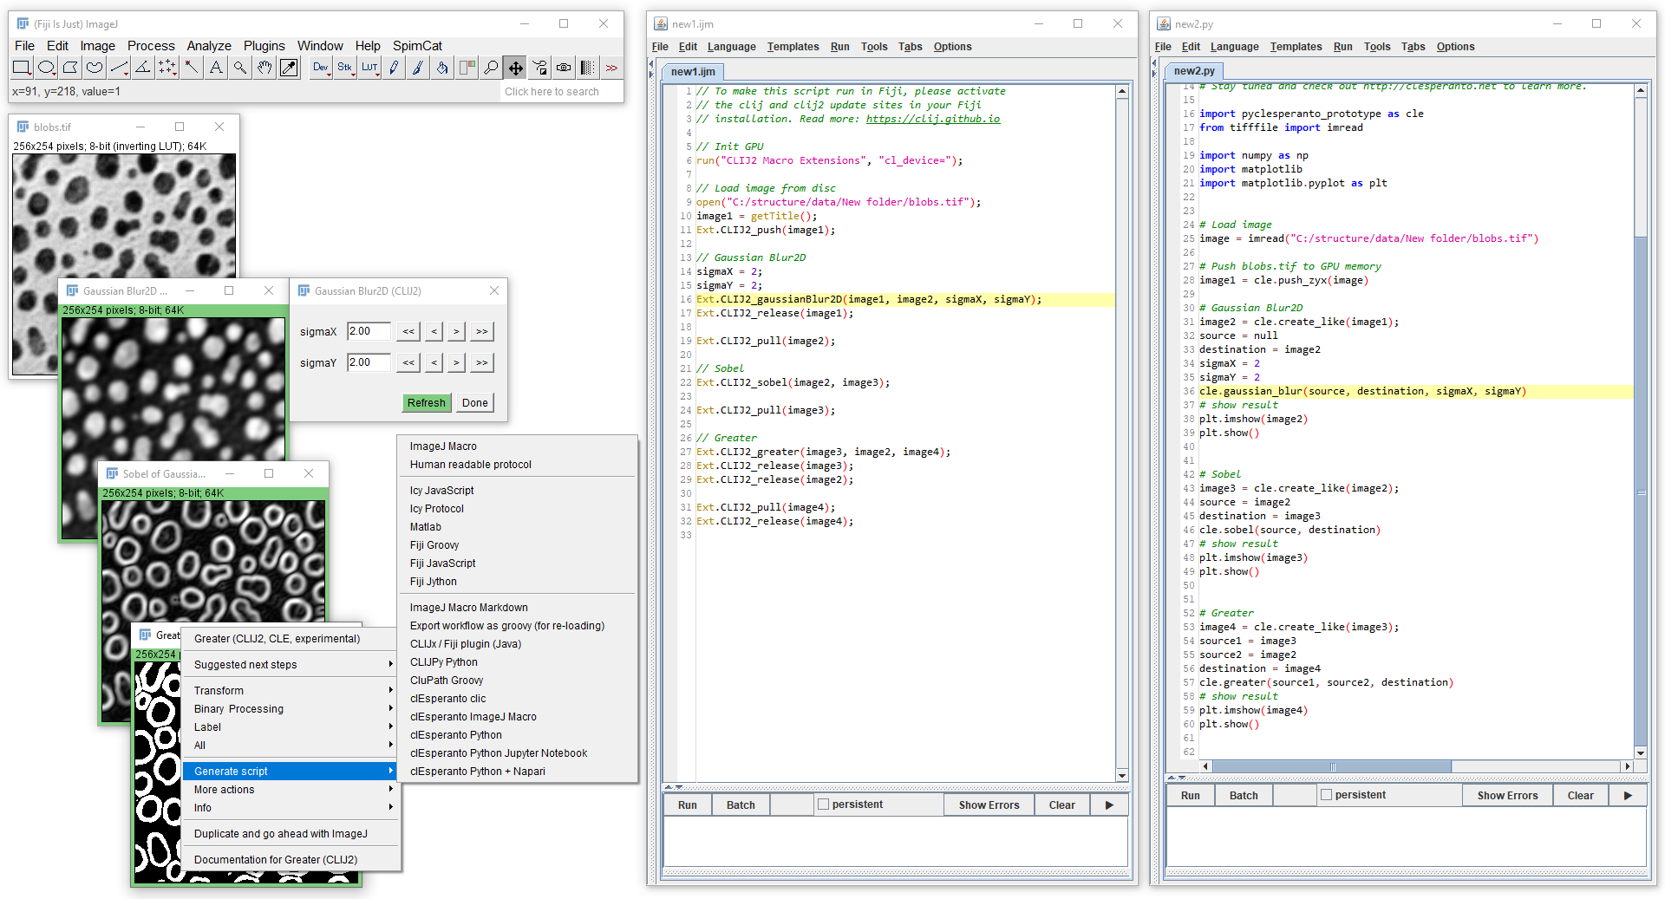
clEsperanto script language comparison
Generate multiple scripts in multiple languages from a given Image Data Flow Graph

Slide 14
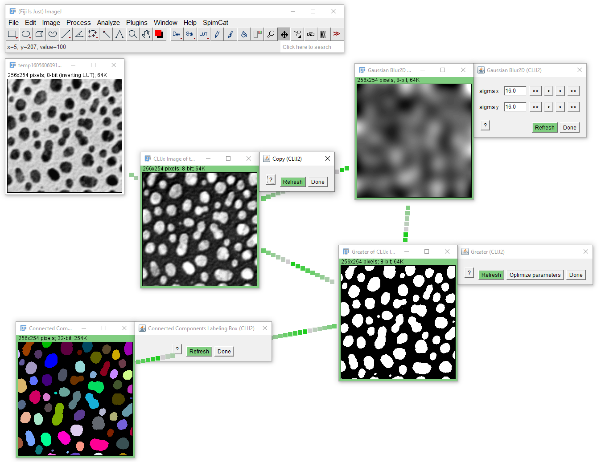
Demo: Segment blobs.gif
Design a workflow for segmenting blobs.gif (File > Open Samples…)
Export the workflow as ImageJ Macro script for and Fiji Jython.
Optional: Export the workflow as Icy Javascript, as Icy protocol and for QuPath as groovy script. Feel free to generate a Fiji plugin.
Furthermore, if you only used operations, which are "py" compatbile, export a clEsperanto-based Jupyter notebook and a Python script that uses Napari.

Slide 15
Demo: Segment blobs.gif

Slide 16
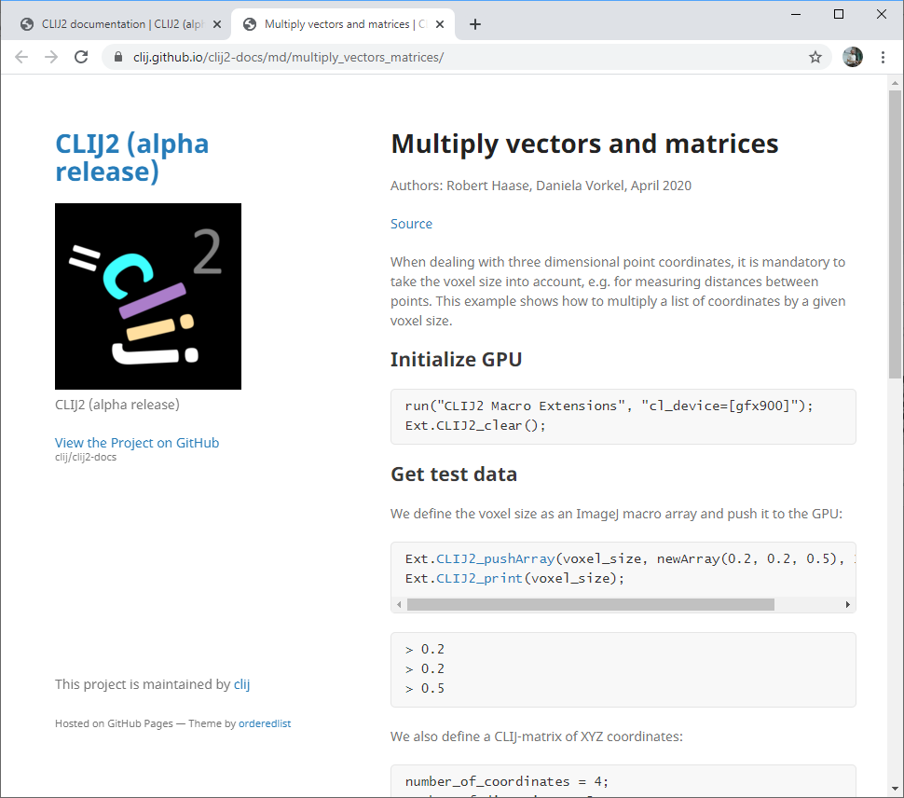
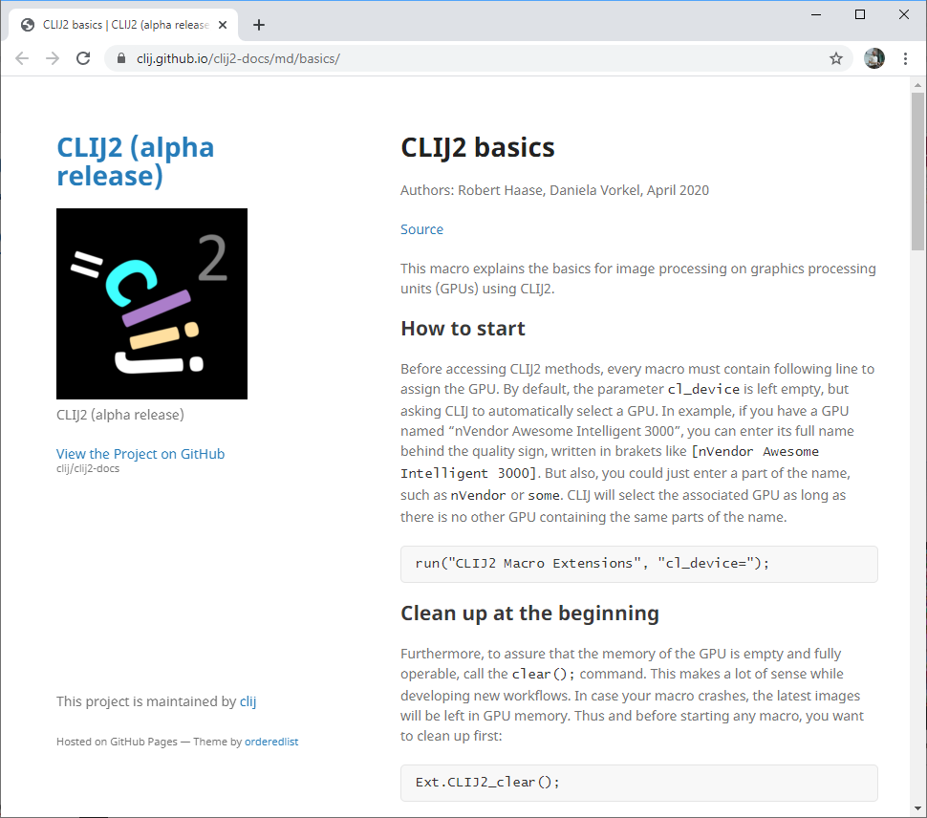
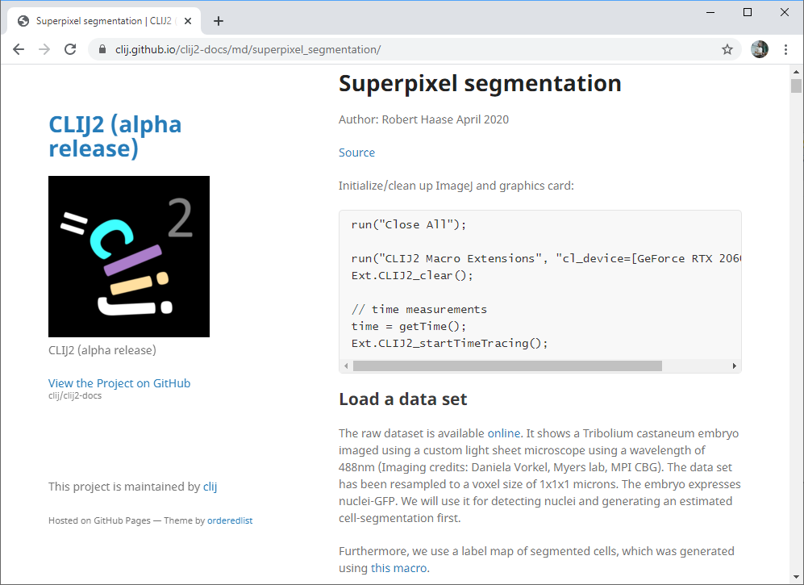
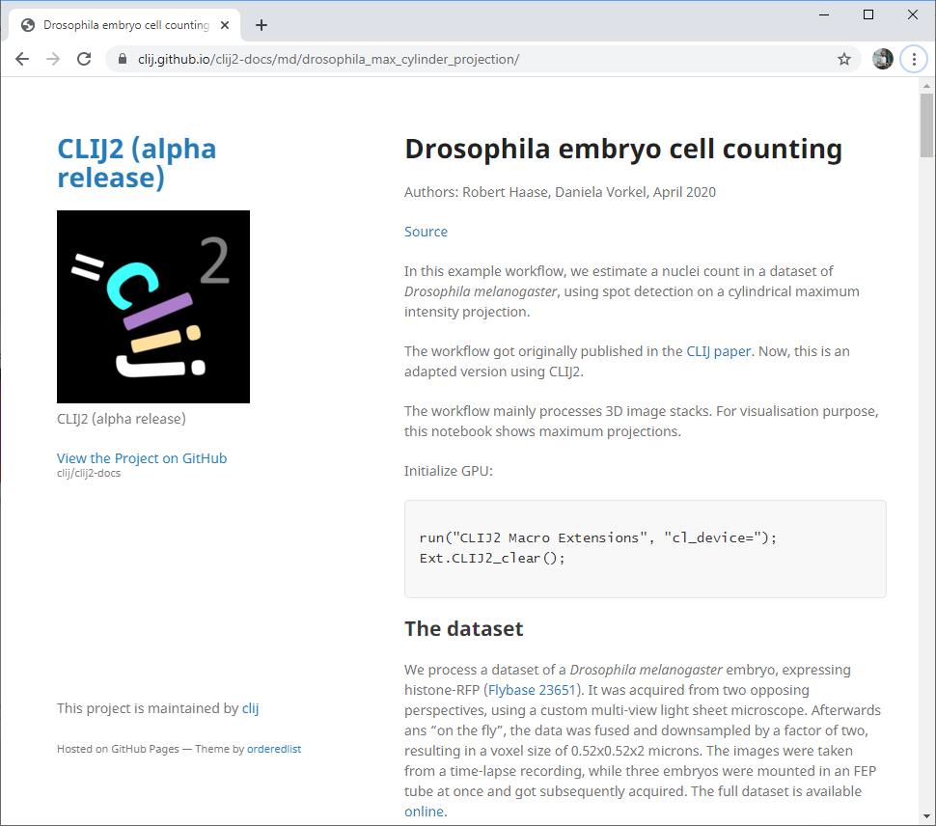
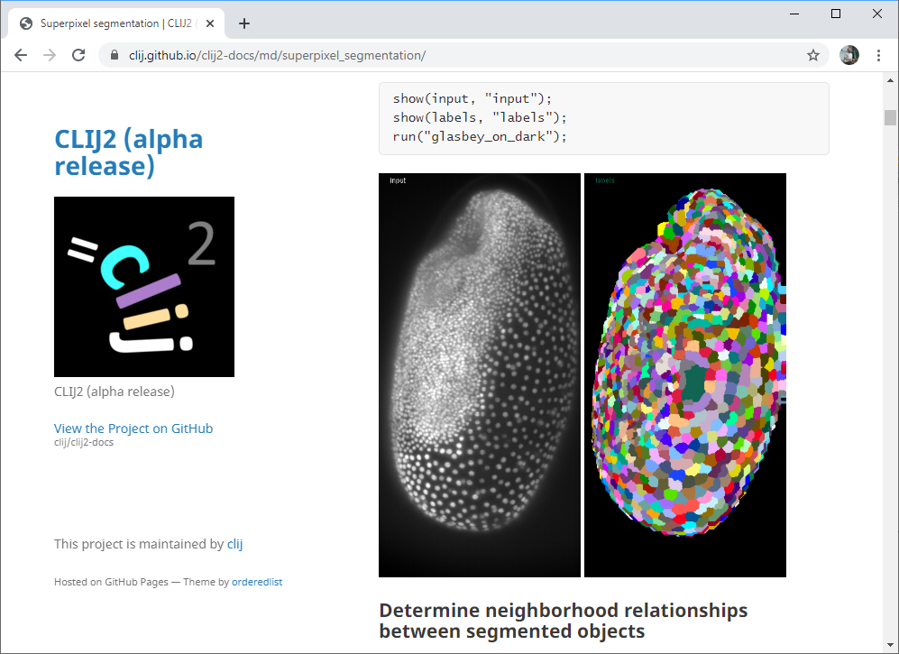
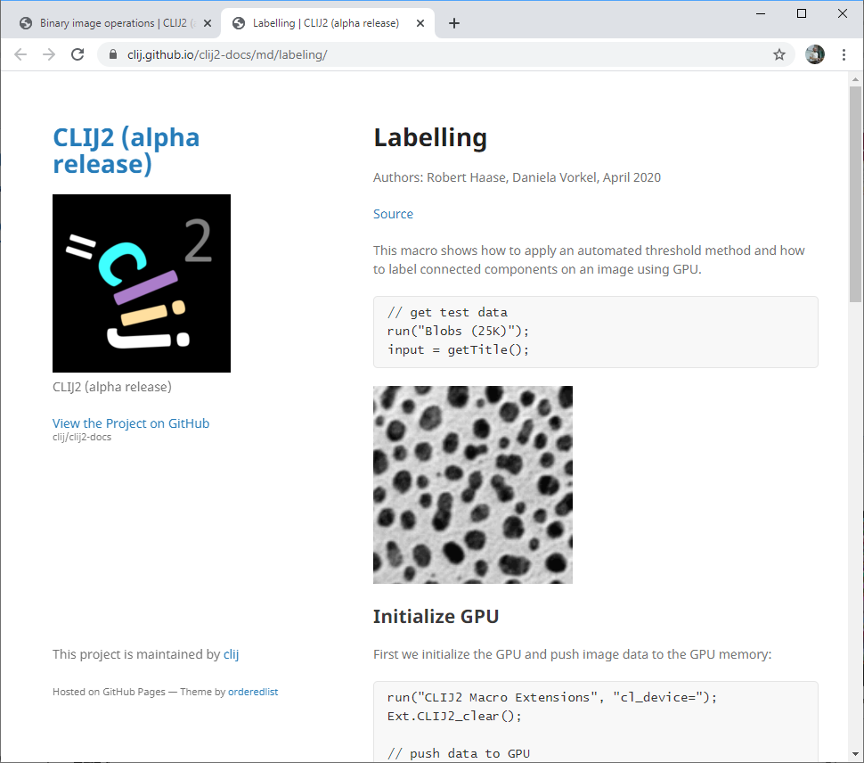
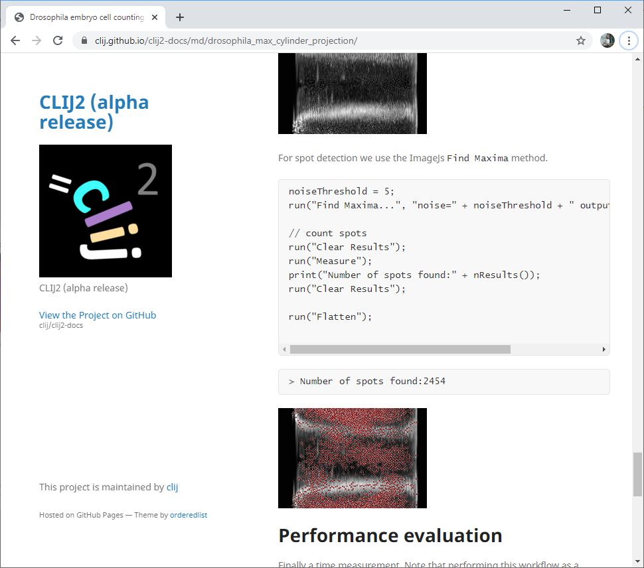
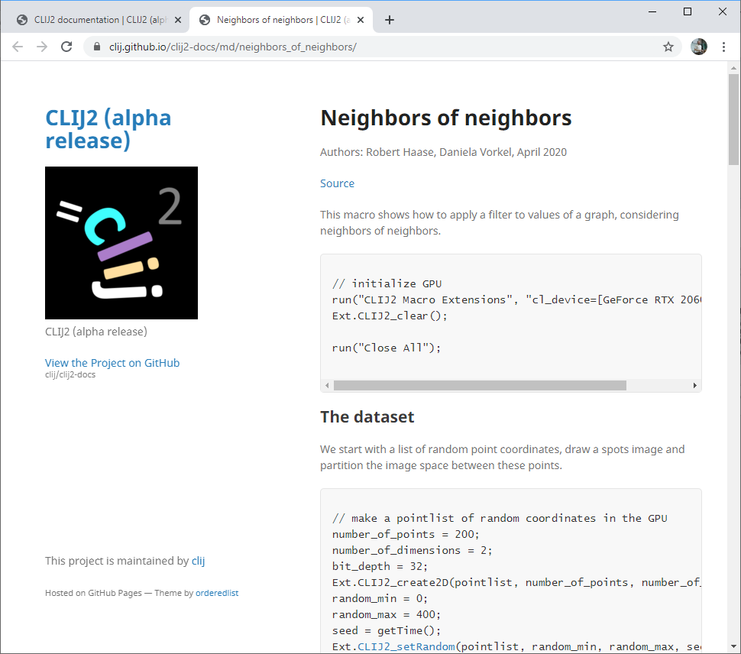
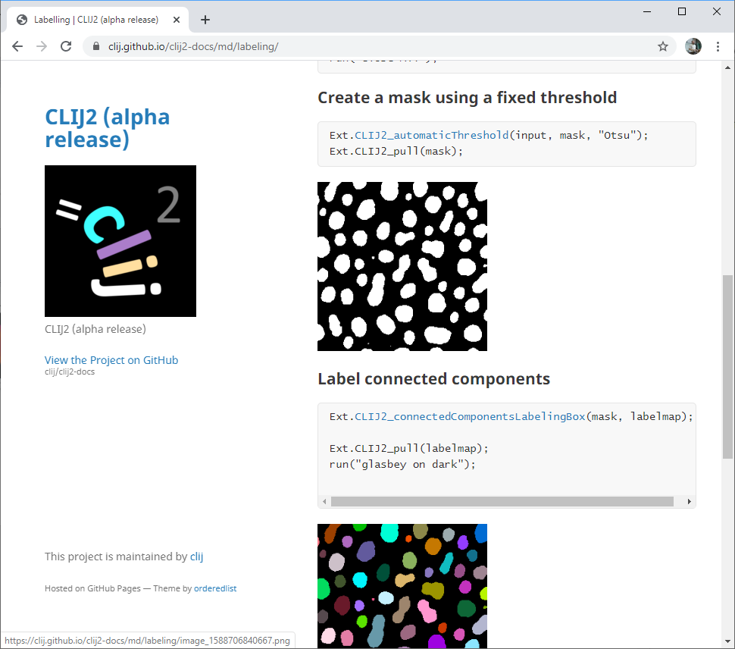
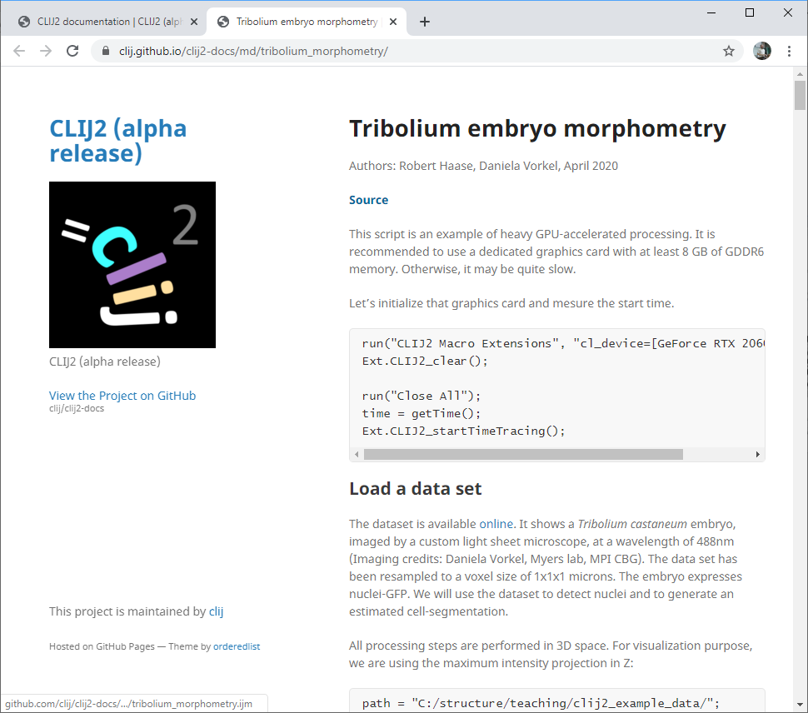
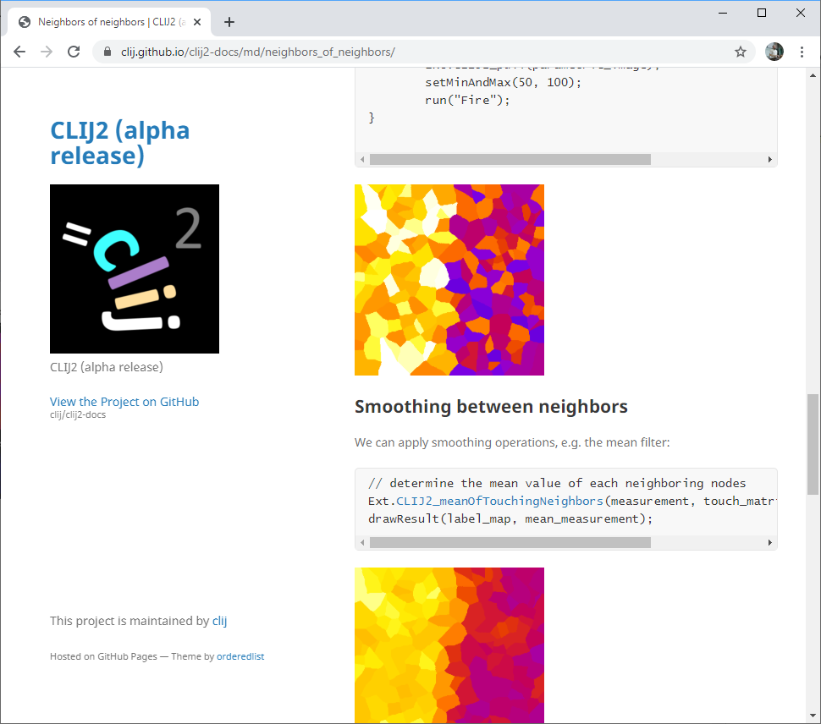
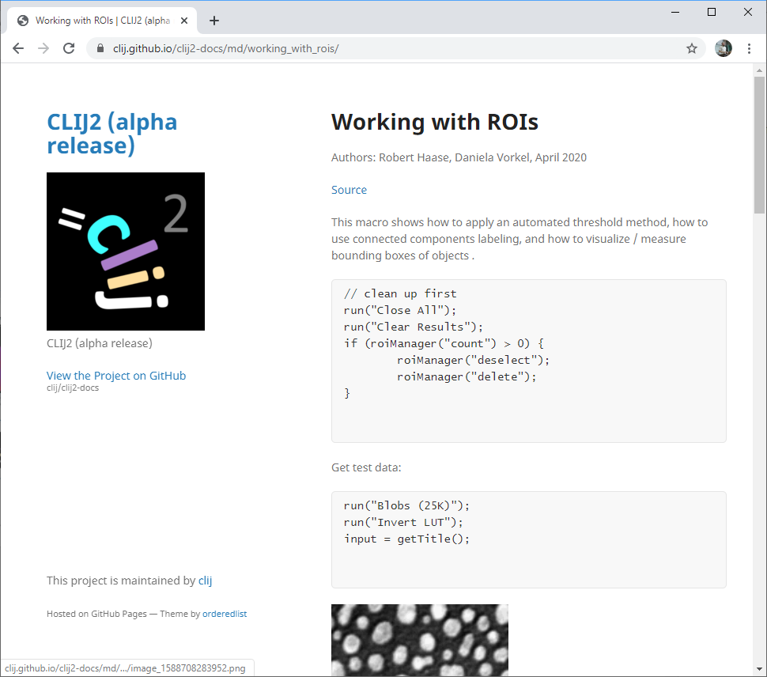
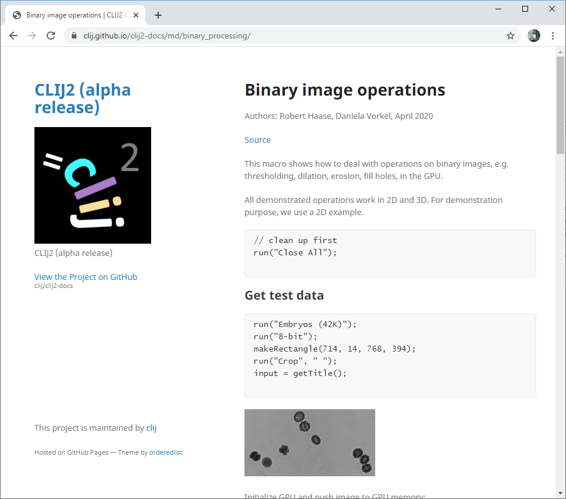
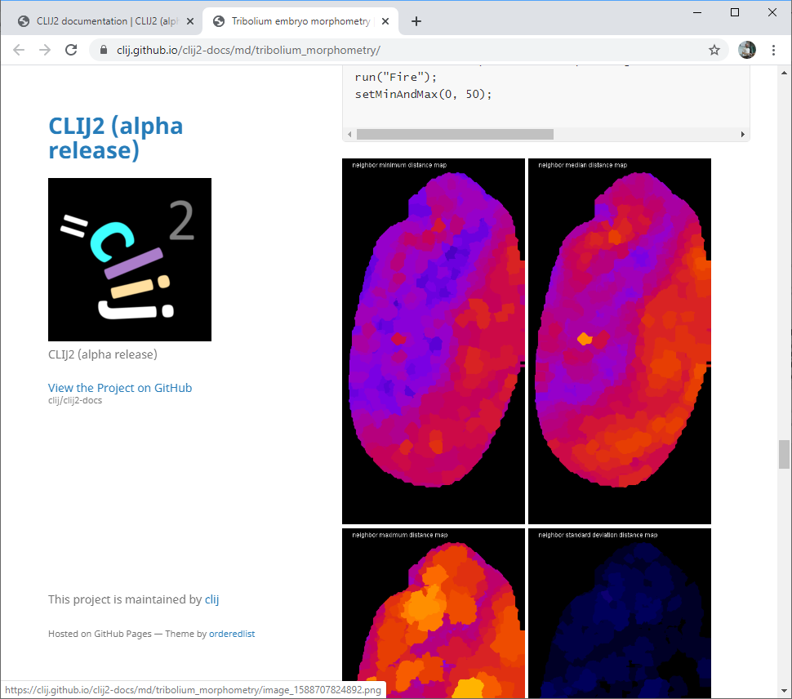
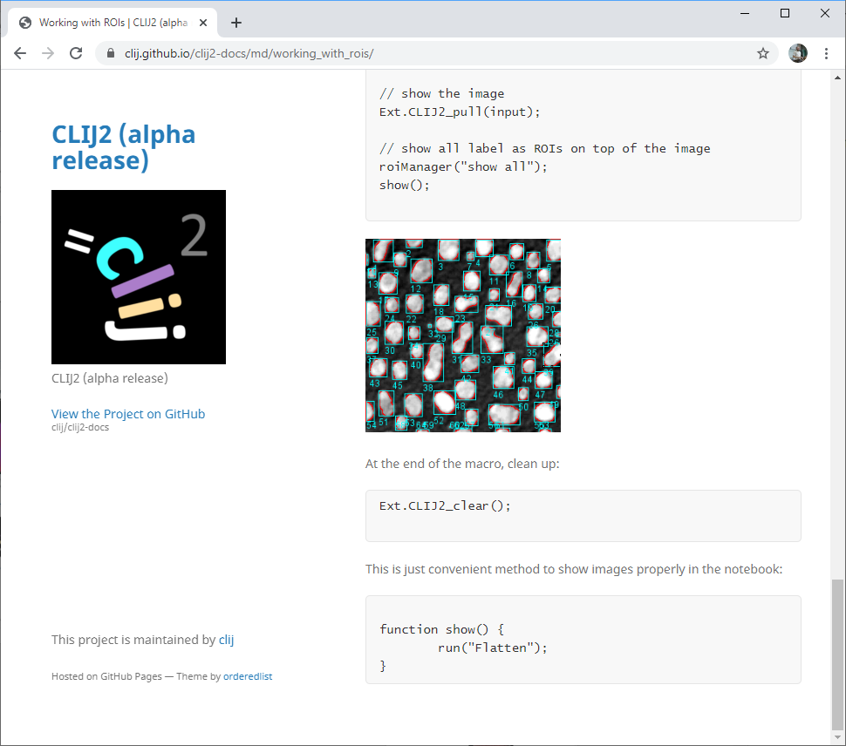
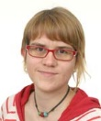
Online documentation: tutorials
Big thanks to
Dani Vorkel
(Myers lab)
@happifocus
https://clij.github.io/

Slide 17
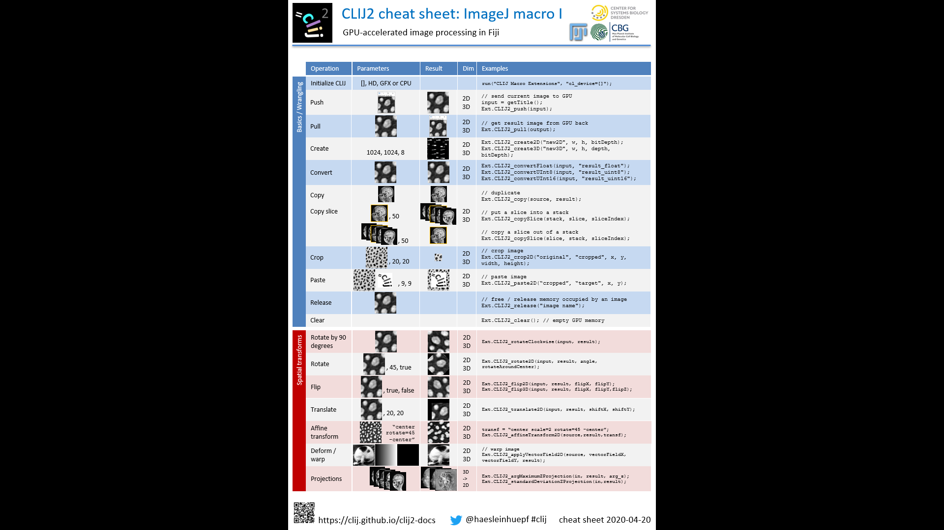
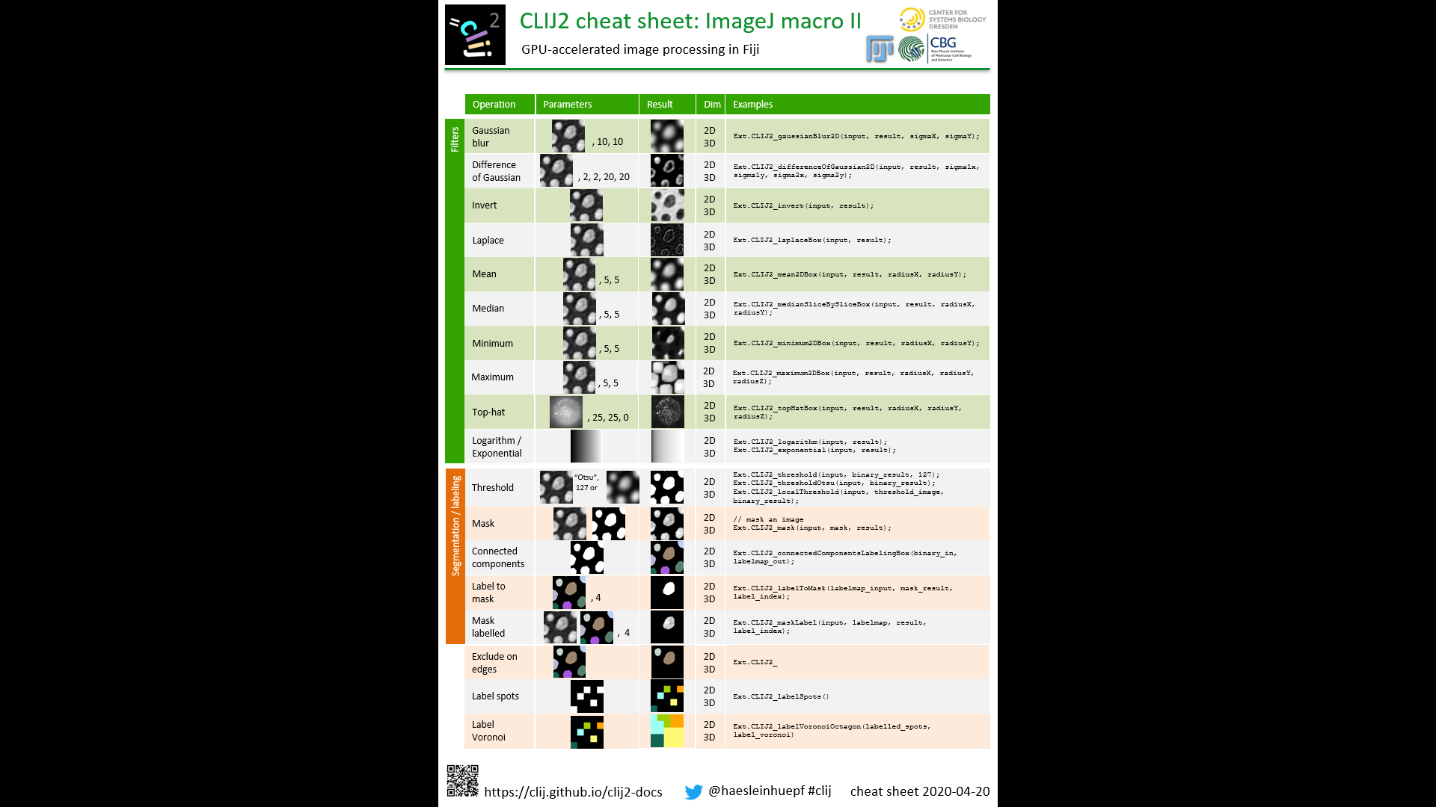
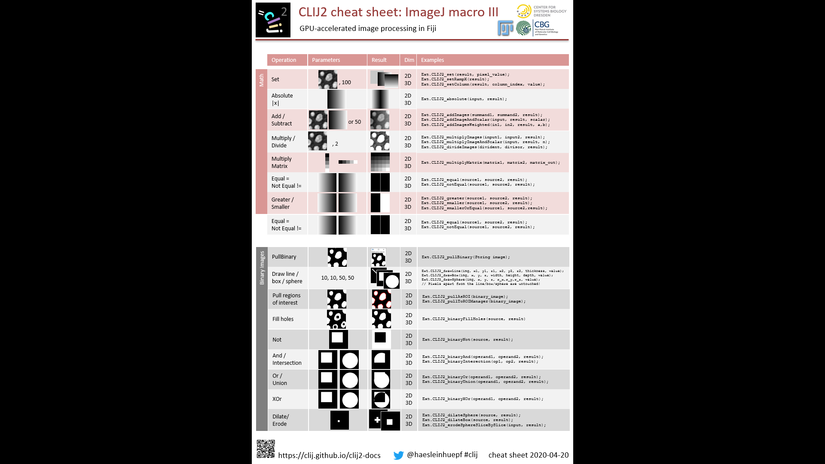
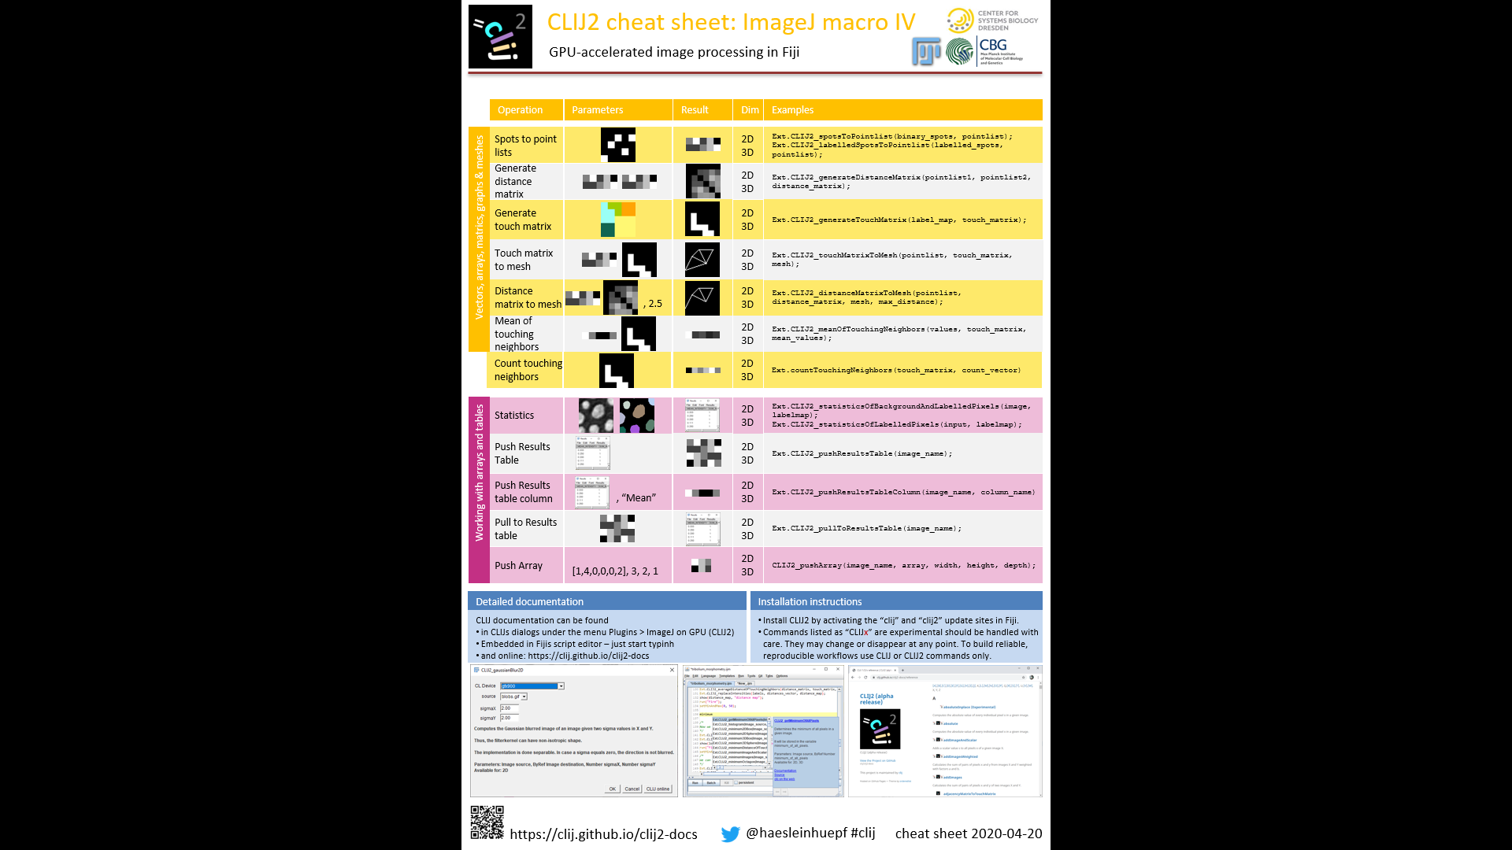
Online documentation: Cheat sheets
Cheat sheets show the most important methods with input and output parameters visually.
https://clij.github.io/clij2-docs/CLIJ2-cheatsheet_V3.pdf

Slide 18
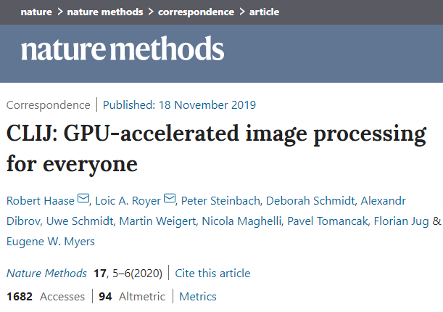
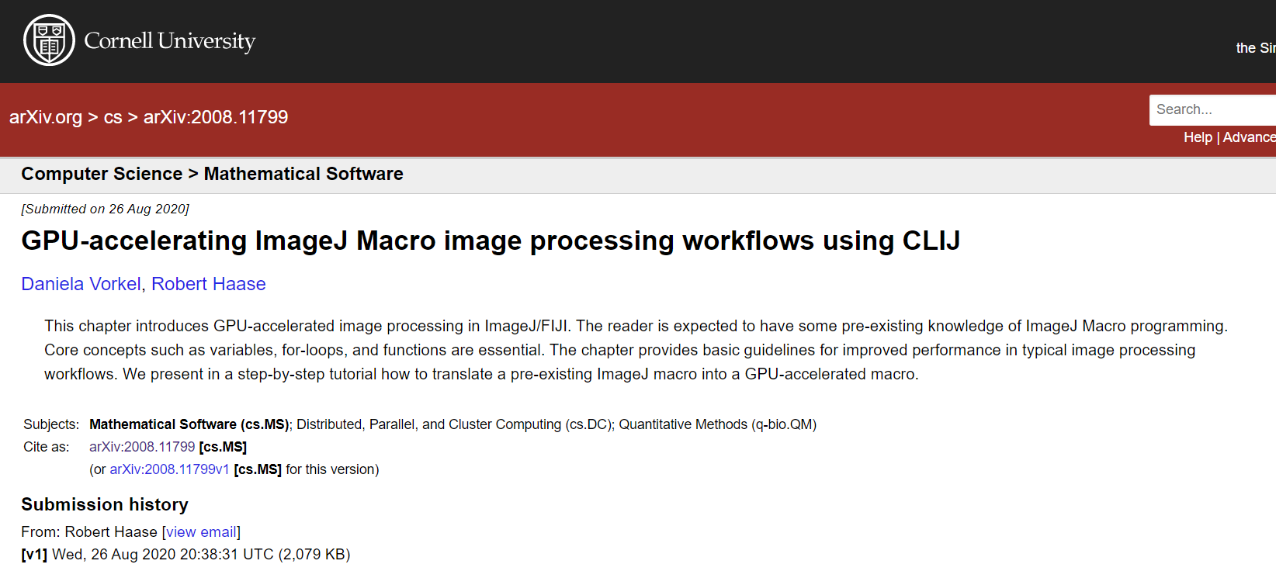
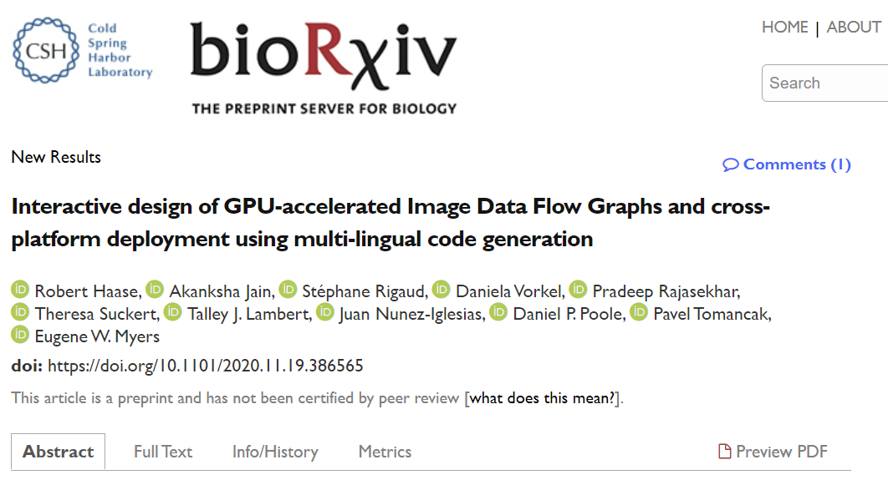
Last but not least: citability
If you work with CLIJ and friends, please cite the paper(s). It’ll be hard to apply for grants otherwise.
https://clij.github.io/

Slide 19
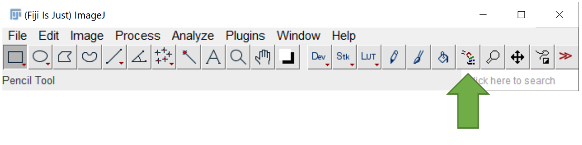
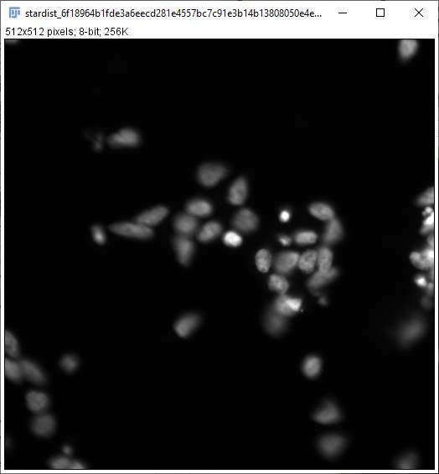
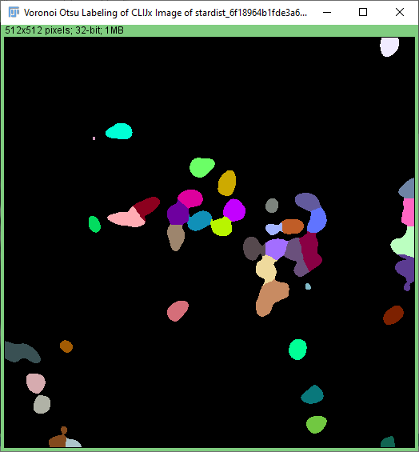
Exercise
Segment a file in this folder using CLIJ:
Day3\startdist_data\
Hint: Convert the image first using menu Image > Type > 8-bit
Optional: Generate a macro and apply it to all images in that folder.
?

Slide 20
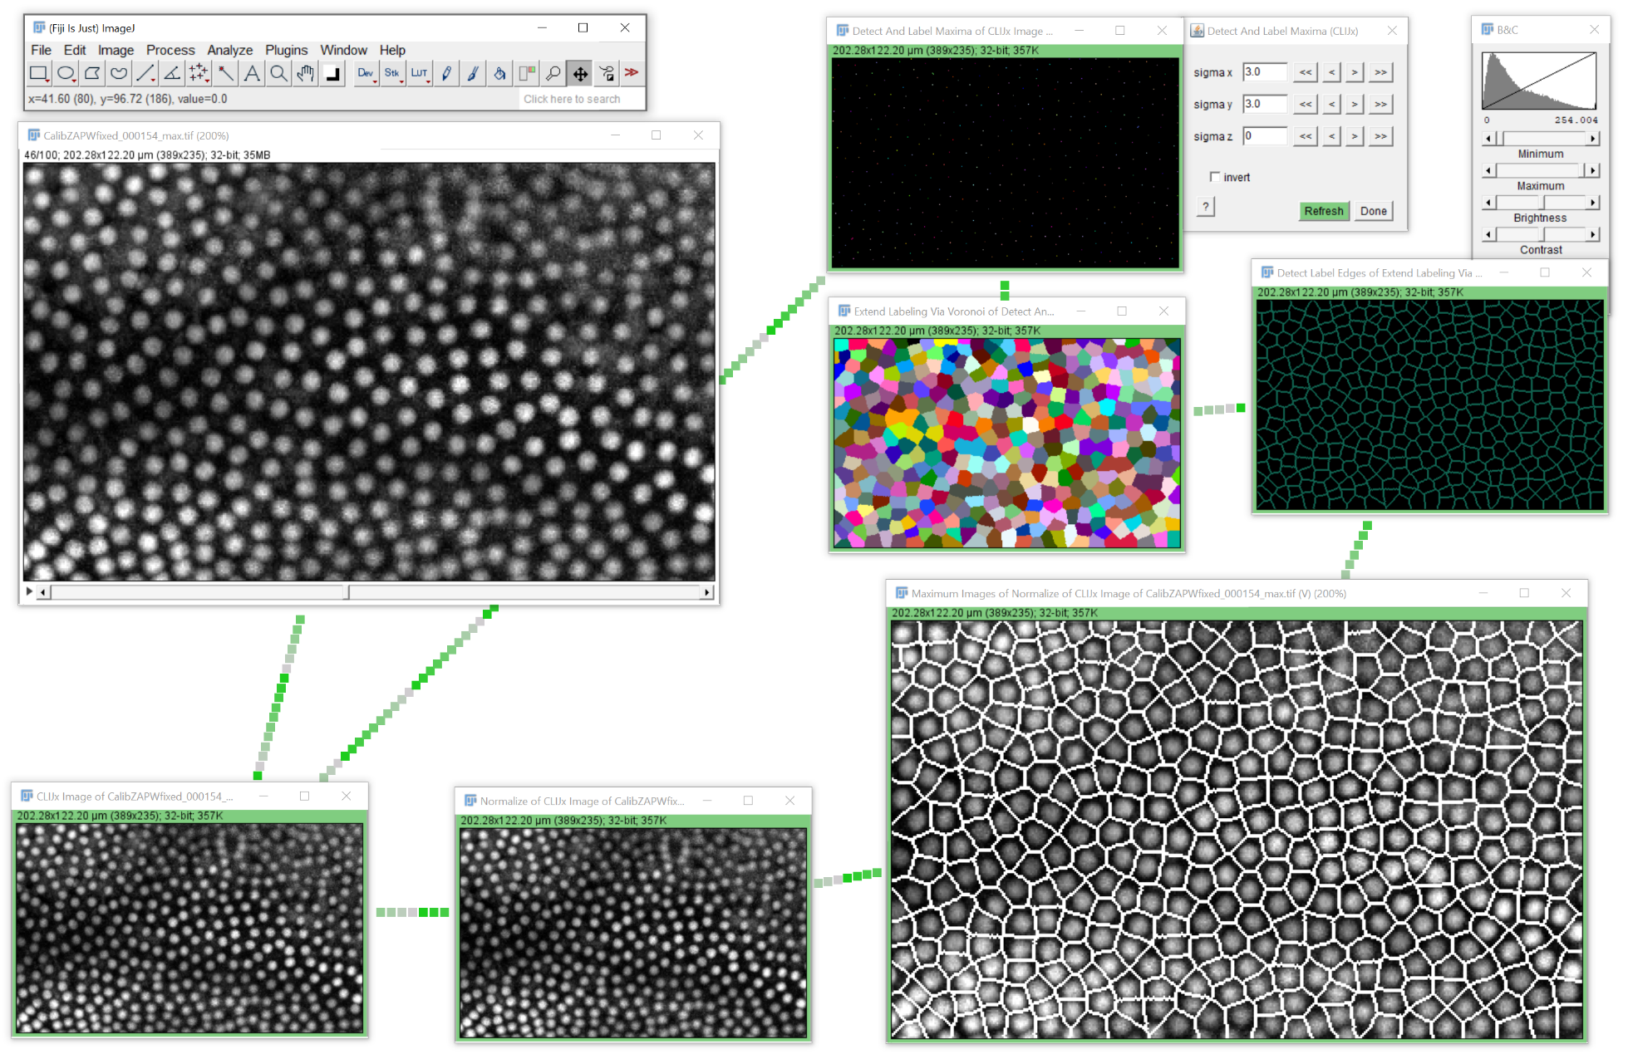
Exercise: Segmentation in time lapse data
Setup a workflow for estimating cell borders between nuclei
Day3\image_data_flow_graphs\
CalibZAPWfixed_000154_max.tif
Export an ImageJ Macro and run it. Note: This exercise will teach you how to deal with errors in generated macro code and how to build in a for loop to process frames individually.

Slide 21
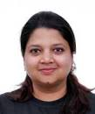
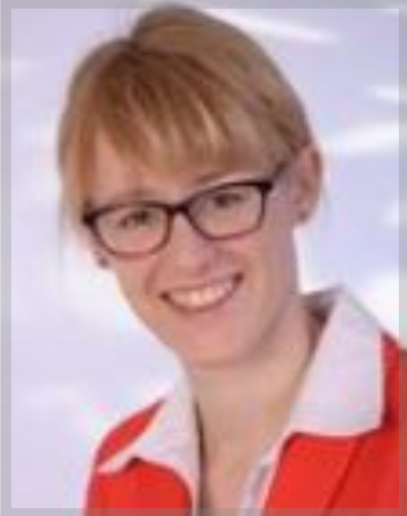
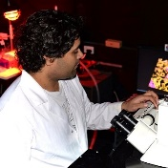

















Acknowledgements
Akanksha Jain
(Treutlein lab)
@jain_akanksha_
Dani Vorkel
(Myers lab)
@happifocus
Theresa Suckert (Krause lab, Oncoray)
Pradeep Rajasekhar (Poole lab, Monash U)
@pr4deepr
Talley J. Lambert
(HMS)
@TalleyJLambert
Juan Nunez-Iglesias (Monash)
@jnuneziglesias
Pavel Tomancak
(CSBD / MPI-CBG)
@PavelTomancak
Gene Myers
(CSBD / MPI-CBG)
@TheGeneMyers
https://fiji.sc
https://napari.dev
Stéphane Rigaud
(Institut Pasteur)
@StRigaud
Jean-Yves Tinevez
(Institut Pasteur)
@jytinevez
Florian Jug
(CSBD / MPI-CBG)
@florianjug
Szabolcs Horvát
(Modes lab)
@szhorvat
Johannes Girstmair
(Tomancak lab)
@jogirstmair
Brian Northon
@truenorth_ia
Matthias Arzt
(Myers/Jug lab)
Alex Herbert (University of Sussex)
Alexandr Dibrov (MPI CBG)
Bertrand Vernay (IGBMC, Strasbourg)
Bert Nitzsche (PoL TU Dresden)
Bradley Lowekamp (NIAID Washington)
Bram van den Broek (Netherlands Cancer Institute)
Brenton Cavanagh (RCSI)
Bruno C. Vellutini (MPI CBG)
Carl D. Modes (CSBD/MPI-CBG)
Curtis Rueden (UW-Madison LOCI)
Damir Krunic (DKFZ)
Daniel J. White (GE)
Deborah Schmidt (CSBD/MPI CBG)
Douglas P. Shepard (Univ Arizona)
Eduardo Conde-Sousa (Univ. of Porto)
Erick Ratamero (The Jackson Laboratory)
Gaby G. Martins (IGC)
Gayathri Nadar (MPI CBG)
Guillaume Witz (Bern University)
Giovanni Cardone (MPI Biochem)
Irene Seijo Barandiaran (MPI CBG Dresden)
Jan Brocher (Biovoxxel)
Juergen Gluch (Fraunhofer IKTS)
Kisha Sivanathan (Harvard Medical School)
Kota Miura
Laurent Thomas (Acquifer)
Lior Pytowski (University of Oxford)
Loic A. Royer (CZ Biohub)
Marion Louveaux (Institut Pasteur Paris)
Martin Weigert (EPFL Lausanne)
Matthew Foley (University of Sydney)
Nico Stuurman (UCSF)
Nicola Maghelli (MPI CBG)
Nicolas Brouilly (IBDM Marseille)
Nik Cordes (Los Alamos National Laboratory)
Noreen Walker (MPI CBG Dresden)
Ofra Golani (Weizmann Institute of Science)
Patrick Dummer
Peter Haub
Pete Bankhead (University of Edinburgh)
Peter Steinbach (HZDR Dresden)
Pit Kludig
Rita Fernandes (University of Porto)
Romain Guiet (BIOP-EPFL)
Ruth Whelan-Jeans
Sebastian Munck (VIB Leuven)
Siân Culley (MRC LMCB)
Stein Rørvik
Stéphane Dallongeville (Pasteur)
Tanner Fadero (UNC-Chapel Hill)
Thomas Irmer (Zeiss)
Tobias Pietzsch (MPI-CBG)
Uwe Schmidt (MPI CBG)
Wilson Adams (VU Biophotonics)
https://image.sc
http://eubias.org/
NEUBIAS/
MPI CBG Core Facilities
Advanced Imaging Facility
Light Microscopy Facility
Scientific Computing
IT Department
Fly lab
Funding:
https://clij.github.io/
R.H. was supported by the German Federal Ministry of Research and Education (BMBF) under the code 031L0044 (Sysbio II) and by the Deutsche Forschungsgemeinschaft under Germany’s Excellence Strategy – EXC2068 - Cluster of Excellence Physics of Life of TU Dresden.

